Slide 1
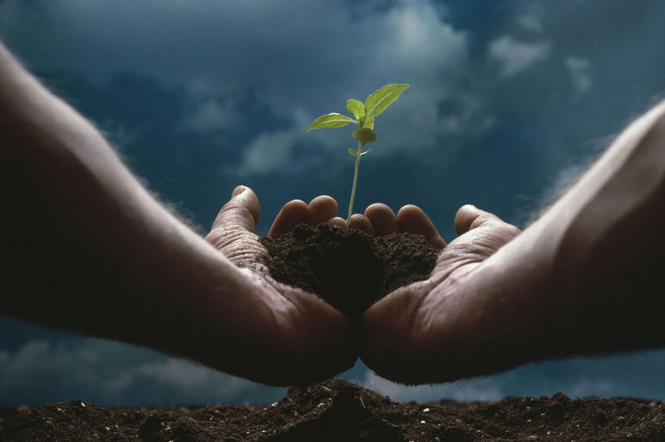
Precious Things
“he also had farmers and vinedressers in the mountains and in Carmel, for he loved the soil” (2 Chron. 26:10)
“highly valued, much loved, or considered to be of great importance” (Encarta)
Notes:
Uzziah was a very successful king from a materialistic point of view because God blessed him for seeking Him. He became king at 16 and reigned 42 years and had great abilities in domestic as well as military endeavors. Beside the fact that he had an elite military of 307,500 and that his fame was spread throughout it says that he had farmers in certain areas because he loved the soil. To Uzziah, the soil was precious and needed.

Slide 2
Precious Things
“Then the servant brought out jewelry of silver, jewelry of gold, and clothing, and gave them to Rebekah. He also gave precious things to her brother and to her mother” (Gen. 24:53)
Notes:
Today we are going to talk about precious things. There are several precious things mentioned in the scriptures. The first explicit statement of something being precious is found in Genesis 24:53 where Abraham’s servant was on a mission to find Isaac a wife and when he found Rebekah and received the approval of her family he not only gave silver, jewelry, gold and clothing to Rebekah, but also gave precious things to her brother and mother. These gifts would have served as the dowry that was then offered for a wife.

Slide 3
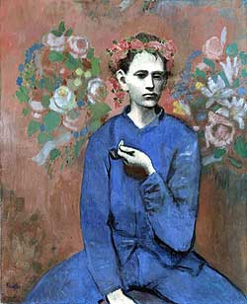
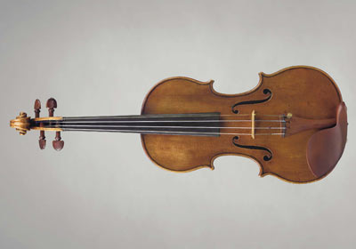
Precious Things To Men Today
Picasso’s – “Garçon à la Pipe” (Boy With a Pipe), painted in 1905, shot up to $104.1 million (http://www.iht.com/articles/2004/05/07/picasso_ed3_.php, MAY 7, 2004)
Rare Violins -Antonio Stradivari’s “Lady Tennant” crafted in 1698 sold for 2.03 million dollars (April 2005)
Notes:
This Picasso broke all previous prices for any one piece of art.

Slide 4
Matt 13:45, 46
“Again, the kingdom of heaven is like a merchant seeking beautiful pearls, who, when he had found one pearl of great price, went and sold all that he had and bought it.”
Notes:
This pearl was valued at more than all that the merchant had. He sought beautiful pearls but there was one pearl which he saw that worth more than all. It was of great price. Now the meaning of this is that the kingdom of heaven should be viewed with such worth. The kingdoms of men may be beautiful but do not compare to the kingdom of Christ. Likewise the churches that men build are of little value compared with the church of God’s choice.
But you can see that people have always sought for special and precious things and have always been willing to pay a large sum for them. Truth is a precious thing that should be secured without being sold (Prov. 23:23)
However, my talking points for today do not revolve around what men may buy and sell in this physical world, but over some precious things that are mentioned in 1st and 2nd Peter.

Slide 5
Precious Things Of God
Precious
Faith
2Pe. 1:1
“Now faith is the assurance of things hoped for, the conviction of things not seen” (Heb. 11:1, NASB)
"Faith demonstrates to the eye of the mind the reality of those things which cannot be discerned by the eye of the body" (Matt. Henry)
Hebrews 10:39
Hebrews 11:1
1 Peter 1: 7
Notes:
The apostle Peter speaks of four precious things in his two letters.
[CLICK] This faith is “like precious,” and is shared among all who obtain it by the righteousness of God. God is the author of saving faith. The faith should be viewed as precious. It is something not to be taken for granted. The world defines faith quite differently. In the classic movie, “Miracle on 34th Street,” Santa Clause uttered, “Faith is believing in things when common sense tells you not to.” This imprints in our minds that faith is irrational and devoid of common sense, knowledge and logic. Now imagine viewing something like that as “precious.” As one person answered, “In reality, the Bible knows of no common sense that is not sensible enough to recognize that God exists and can do anything.”
Faith is a precious thing that saves our soul (Heb. 10:39). How much emphasis we place on our own soul relates how much we value the faith.
[CLICK] Faith is something that substantiates or gives a strong standing ground for our hope as well as provides a conviction of things not seen (Heb. 11:1). Hebrews 11:1 speaks of two acts of faith. 1) It substantiates hope. 2) It gives confidence, conviction, evidence of things not seen. “The evidence of things not seen” is one of the acts of faith. Faith is like hands that lay hold on God’s word and then like eyes that behold the reality of the unseen in a convincing fashion.
It has been explained before by imagining two people standing on the deck of a large ship far out in the sea. One asks, “Do you see that?” The other replies, “See what? There is nothing but the open sea with nothing else in view.” The other person responds, “A large sea vessel is coming our way” and then proceeds to describe its details handing the other fellow his telescope. The one man’s glass enabled him to look beyond the limitations of the natural eye. He spoke confidently by what he saw. God’s word is that way for us. It is our telescope into the unseen. It allows us to have a longer and deeper range of true vision and reality than the limitation of our physical senses. It telescopes our vision where only the eye of faith can view that which is otherwise invisible. Faith, brings the conviction or the “evidence” (NKJV) of things not seen to view.
Faith is something that is tested 1 Peter. 1:7. Make no mistake about it. Your faith may be tested to see if your thinking is genuinely supported by the Bible fact or man’s delusion. It may be outward persecution. It may be a family situation that might make you question God’s word. It may be a sermon. It may be the abrasive cutting of the word when it is preached that has an ill-effect upon another. You know some don’t like the “repent” aspect of the faith. No one is immune to having their faith tested but we must all pass the tests if we are going to be saved.
The lack of faith results in the lack of God’s approval and is considered an evil state of the heart (Heb. 11:6; 3:12).

Slide 6
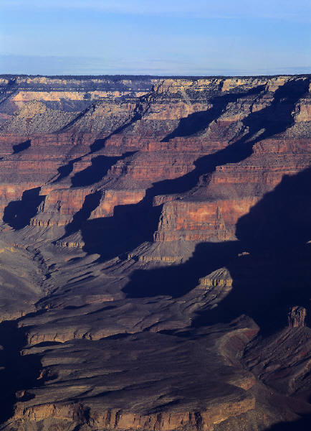
The “Precious Faith” in UNDERSTANDING the Past
“By faith we understand that the worlds were framed by the word of God, so that the things which are seen were not made of things which are visible” (Heb. 11:3, NKJV)
Affirms that the Genesis account of creation can be UNDERSTOOD!
Worlds
Not eternal
Did not create themselves
Were created by word of God
1st believe it in God’s word; 2nd understand it in nature
The word of God is the bare source for faith!
Notes:
[CLICK] None of us have seen the creation of the world be by faith we see it. We cannot understand it, unless we see it by faith. Can you understand the Grand Canyon unless you see it? You must either visually see it with you eye or you must be able to see it with your mind’s eye. But until you perceive what is meant by “Grand” and “Canyon” you cannot understand it.

Slide 7
Precious Things Of God
Precious
Faith
Promises
2Pe. 1:1
2Pe. 1:4
“by which have been given to us exceedingly great and precious promises, that through these you may be partakers of the divine nature, having escaped the corruption that is in the world through lust” (2 Pet. 1:4)
Notes:
Promises
Read 2 Peter 1:3, 4. These precious promises are the object of the precious faith. These promises are linked to life and godliness. They are called exceedingly great and precious. This is of far more value than a Picasso painting or rare violin. Through these promises you may partake of the divine nature. Now they are called promises. “A promise is an assurance on the part of another of some good for which we are dependent on him” (Barnes).
Divine Nature – We are already partakers of the Holy Spirit (Heb. 6:4); and yet we “may” partake of his holiness (Heb. 12:10). When it says “may be partakers of the divine nature” we can conclude that this is opposed to the pantheistic idea that now all things are a part of God. If that be true, then we who are something would already be a part of God. But “may be partakers” seems to mean that we presently are not but that there is something more in store.
We may infer that man alone has the capability to partake of this promise. None of the animals have that right. It seems that this nature is what he called us by (v. 3) of glory and virtue and perhaps we can partake of that some now when obey the gospel and grow in the grace and knowledge of the Lord and are members of His body, of His flesh and bones (Eph. 5:30). Indeed, in a spiritual sense, we sit with Christ in heavenly places now (Eph. 2:6). It may also relate to the reward of the faithful in heaven when we are able be like Him and see God as he is (1 Jn. 3:2). We know that in heaven, there is a completion of all that is going on here and while we strive to live without sin in this life, we will one day live in a world with no sin. While we strive to understand death, we will one day overcome it and share in, experience and fully understand true life.
It is hard to understand even in this life how a man can go from a baby who knows nothing and can do nothing to what he is when he matures in life and all the skills that he acquires. Yet, imagine the heights that are climbed and the accomplishments that are there for all faithful men and women in Christ at the resurrection of the dead? Imagine what they have become.
Do you understand that there are precious promises for you in eternity (see Jn. 14:1-3; Rom. 2:6, 7; etc.).

Slide 8
Precious Things Of God
Precious
Faith
Promises
Blood
2Pe. 1:1
2Pe. 1:4
1Pe. 1:19
Christ
1Pe. 2:4-7
Ephesians 2:13
Notes:
What makes these promises secure and real is the price that was paid. The precious blood of the Lamb of God. Do you understand that without the shedding of blood, there is no remission of sins (Heb. 9:22)? If Jesus didn’t die, then no one would be saved. Do you realize that we were once afar off? That is, we were way off! We were far removed from God. We were senseless and foolish. But through Christ we have been brought near to God. [CLICK] “But now in Christ Jesus you who once were far off have been brought near by the blood of Christ” (Eph. 2:13).
One of the underlining themes of Hebrews is that we can attain confidence with God. Our faith in God is to bring confidence in God. Our faith in the blood of the Lamb, is to bring confidence in all our religious services and walk, (see. Heb. 10:14-25). Note “boldness” verse 19 and “full assurance” in verse 22. Since Jesus did these things and since we have applied the blood to our soul we should have confidence in prayer and everything (cf. Eph. 3:12), “in whom we have boldness and access with confidence through faith in Him.” There should be a full assurance of faith. The blood of Christ is sufficient for you. Do you believe that?
This leads us to our last point [CLICK, read 1 Pet. 2:4-7] Christ is precious if I were to say nothing more than what I have already said, that point should speak clearly to us.
We might note here that what is precious in God’s view can be rejected and esteemed little by man (1 Cor. 1:18). Man rejected Him but we receive Him. We again see the confidence that we should have in God here. He who believes in Him will not be put to shame (v. 6). “Belief” is again mentioned in v. 7 and for those of us who believe, Jesus is precious. So if you don’t hold Jesus as precious, then do you really believe? Further, believe here means “obedient faith” by its mere contrast with “disobedient.” When you don’t obey, you reject Jesus. This is used similarly in Hebrews 3:18, 19.

Slide 9
So Are You In Christ?
“Blessed be the God and Father of our Lord Jesus Christ, who has blessed us with every spiritual blessing in the heavenly places in Christ” (Eph. 1:3)
“since Abraham shall surely become a great and mighty nation, and all the nations of the earth shall be blessed in him” (Gen. 18:18)
“For as many of you as were baptized into Christ have put on Christ… And if you are Christ’s, then you are Abraham’s seed, and heirs according to the promise” (Gal. 3:27, 29)

Slide 10
Are You Abiding In Christ?
“Then Jesus said to those Jews who believed Him, ‘If you abide in My word, you are My disciples indeed’” (Jn. 8:31)
“And now, little children, abide in Him, that when He appears, we may have confidence and not be ashamed before Him at His coming” (1 Jn. 2:28)

